Slide 1
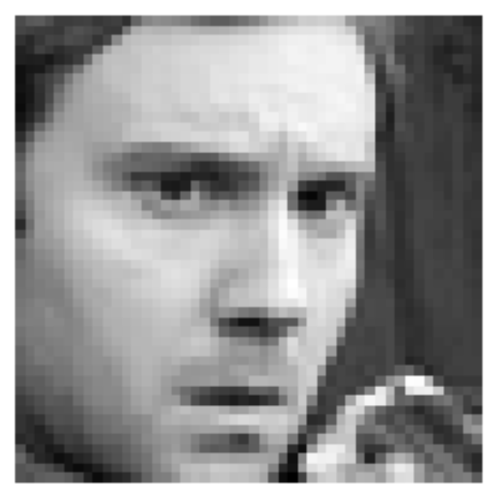
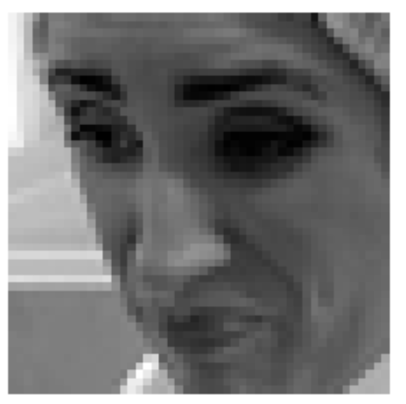
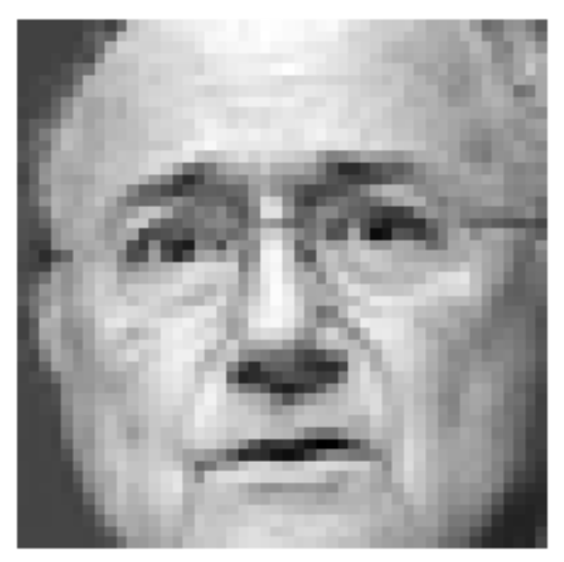
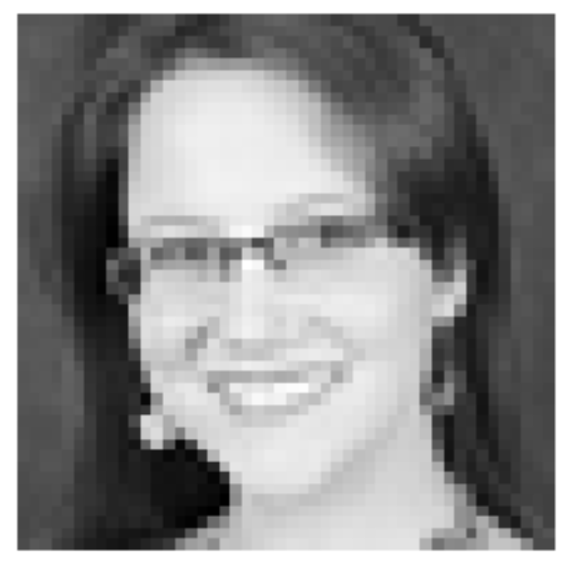
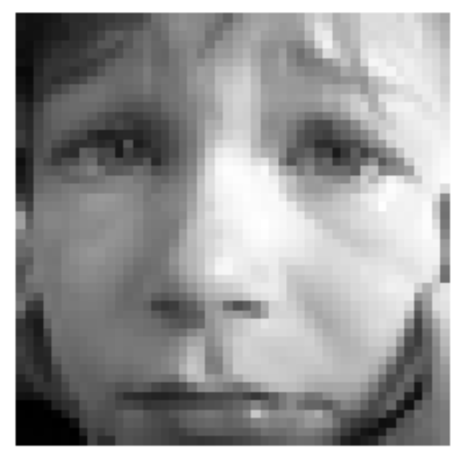

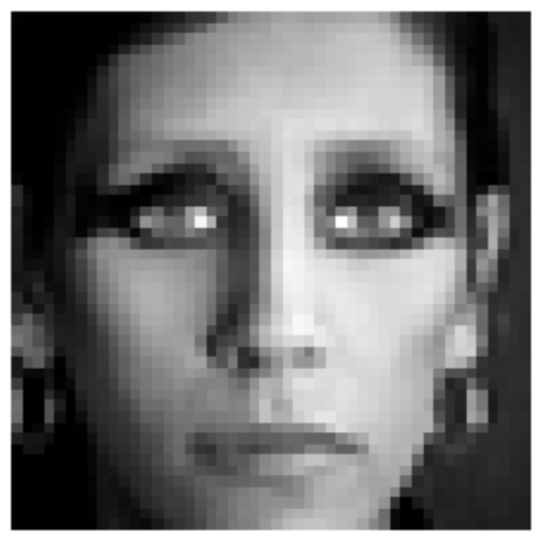
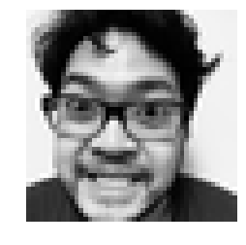
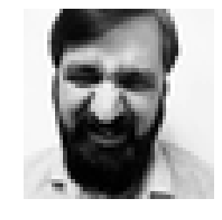
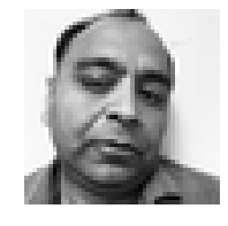
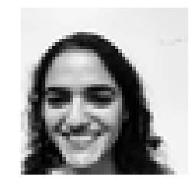
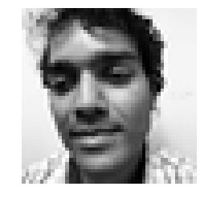
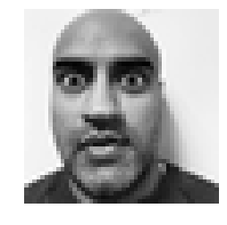
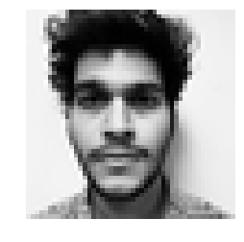
Facial IMAGE RECOGNITION
0=Angry, 1=Disgust, 2=Fear, 3=Happy, 4=Sad, 5=Surprise, 6=Neutral
Team bengio:
Akshay Agarwal kannu priya arora vinod elangovan Gaurav GIRDHAR
Pankaj mittal claude phan Sandeep Kataria

Slide 2
Data source: https://www.kaggle.com/c/challenges-in-representation-learning-facial-expression-recognition-challenge/data Challenge hosted by Ian Goodfellow (Google) in 2013
Methodology:
Unsupervised:
Expectation Maximization
Supervised:
Logistic Regression Classifier (w/ and w/o PCA)
Linear Classifier (w/ and w/o PCA)
Bayesian Classifier (w/ and w/o PCA)
Histogram Classifier (w/ and w/o PCA)
Neural Networks
Training data size:
28,709 samples
89% of complete set
Each sample is 2304 features long (48x48 grayscale images)
Test set:
3,589 samples
~11% of complete set

Slide 3
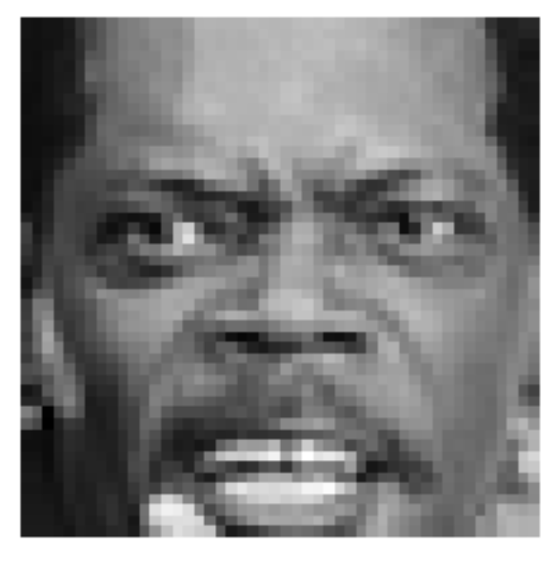
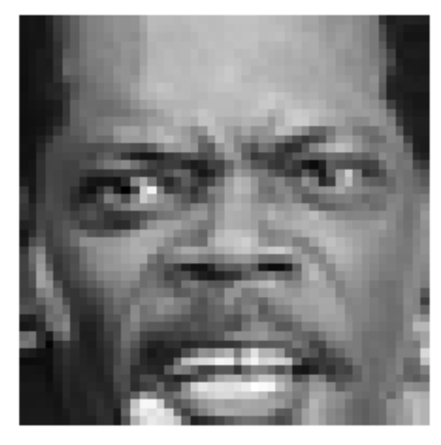
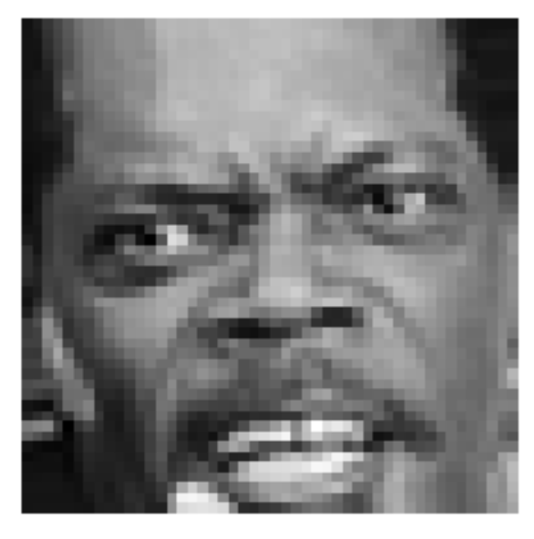
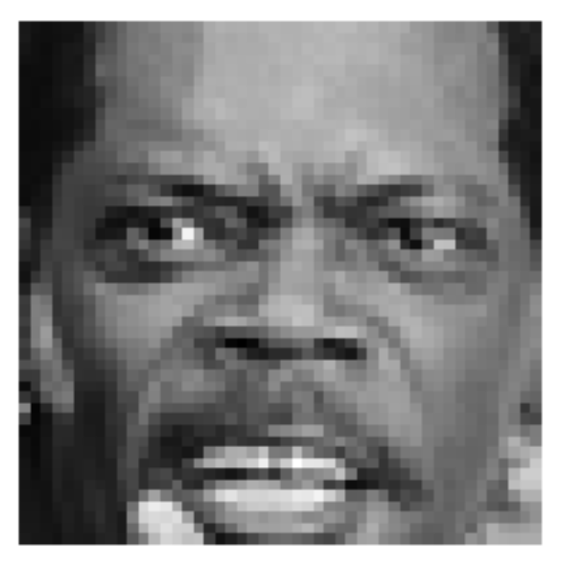
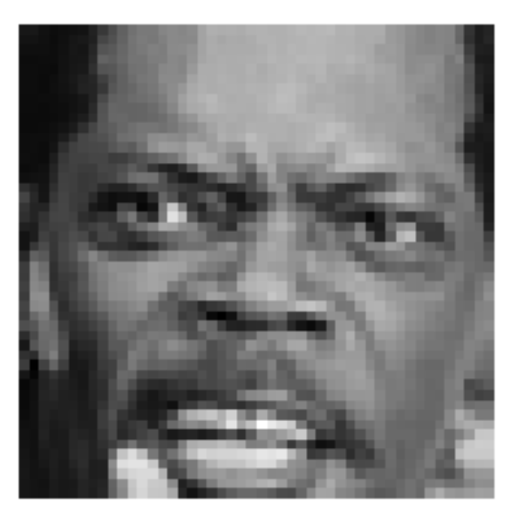
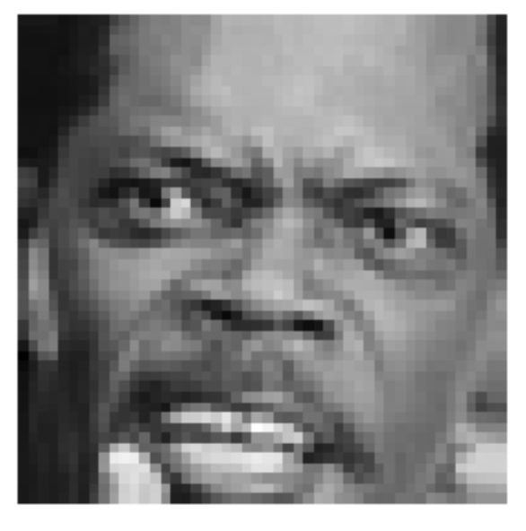
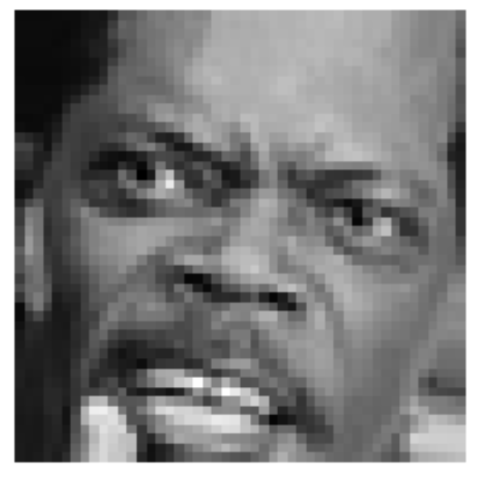
Data Augmentation: Data Size Increase using Image Rotation
3 degrees
6 degrees
10 degrees
Left
Right

Slide 4
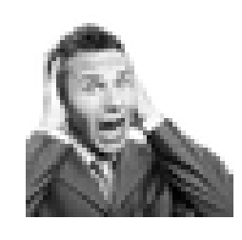
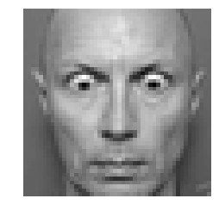
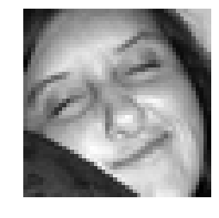
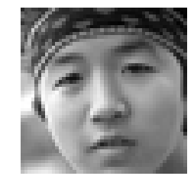
Unsupervised model:
Expectation Maximization analysis
Class Labels | GT Count | EM Count | Sensitivity | PPV
0 = Angry | 3995 | 4156 | 16.0010 | 16.6458
1 = Disgust | 436 | 4423 | 1.7409 | 17.6606
2 = Fear | 4097 | 3993 | 18.6326 | 18.1596
3 = Happy | 7215 | 3719 | 21.3230 | 10.9910
4 = Sad | 4830 | 4068 | 19.5428 | 16.4596
5 = Surprise | 3171 | 4528 | 13.2067 | 18.8584
6 = Neutral | 4965 | 3822 | 16.5260 | 12.7492
True=Fear |Pred.=Fear
True=Surprise |Pred.=Surprise
True=Disgust |Pred.=Happy
True=Neutral |Pred.=Sad
Overall model accuracy = 14.9953%

Slide 5
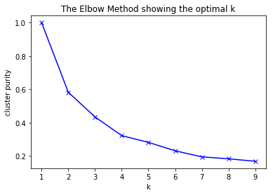

Cluster Purity: soft or hard clusters
K-means
Purity is a measure of the extent to which clusters contain a single class. Its calculation can be thought of as follows: For each cluster, count the number of data points from the most common class in said cluster. Now take the sum over all clusters and divide by the total number of data points

Slide 6
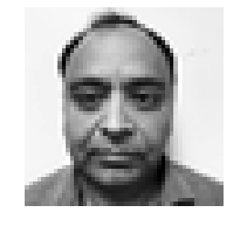
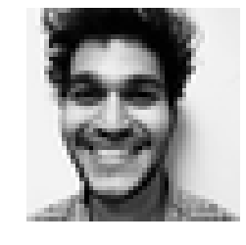
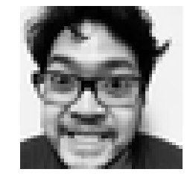
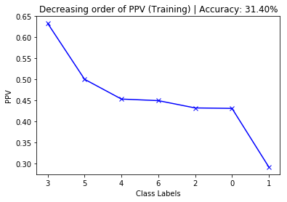
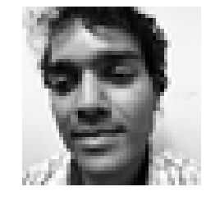
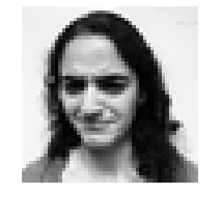
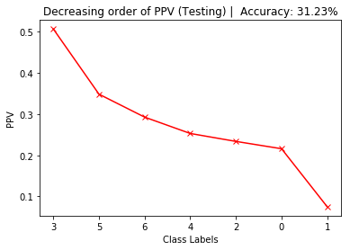
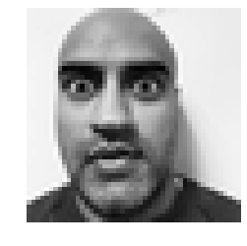
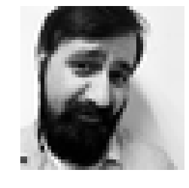
Classes: 0=Angry, 1=Disgust, 2=Fear, 3=Happy, 4=Sad, 5=Surprise, 6=Neutral Logistic Regression classifier
New Test Data: 14% Accuracy
True=6 |Pred=0
True=3 | Pred=0
True=0 | Pred=0
Used 19 PC’s on Training set explaining 75% of the variability
Exact same results as the data with all the 2304 features.
Training Set Accuracy: 31.4%
Test Set Accuracy: 31.23%
True=4 | Pred=3
True=1|Pred=1
True=5 |Pred=6
True=2 | Pred=1

Slide 7

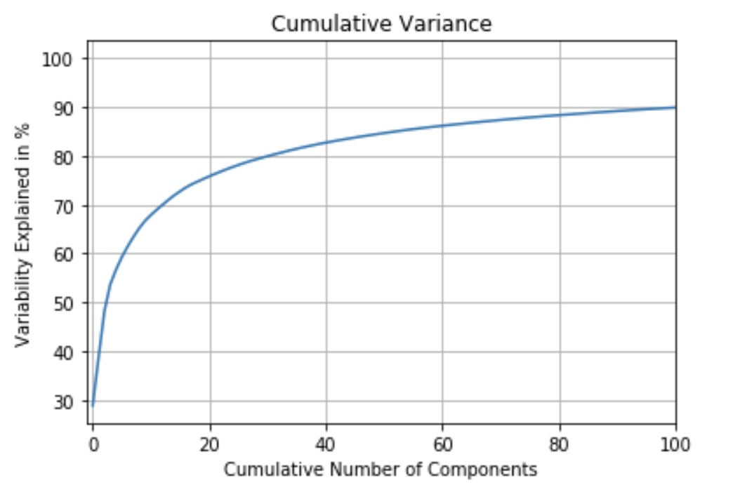

linear classifier
48% Accuracy on Training Data
34% Accuracy on Test Data
Attempted to use PCA with 350 components, yet accuracy was slightly worse.
16% Accuracy on New Data
Label = 1 (Disgust)
Predicted = 3 (Happy)
Label = 6 (Neutral)
Predicted = 6 (Neutral)

Slide 8
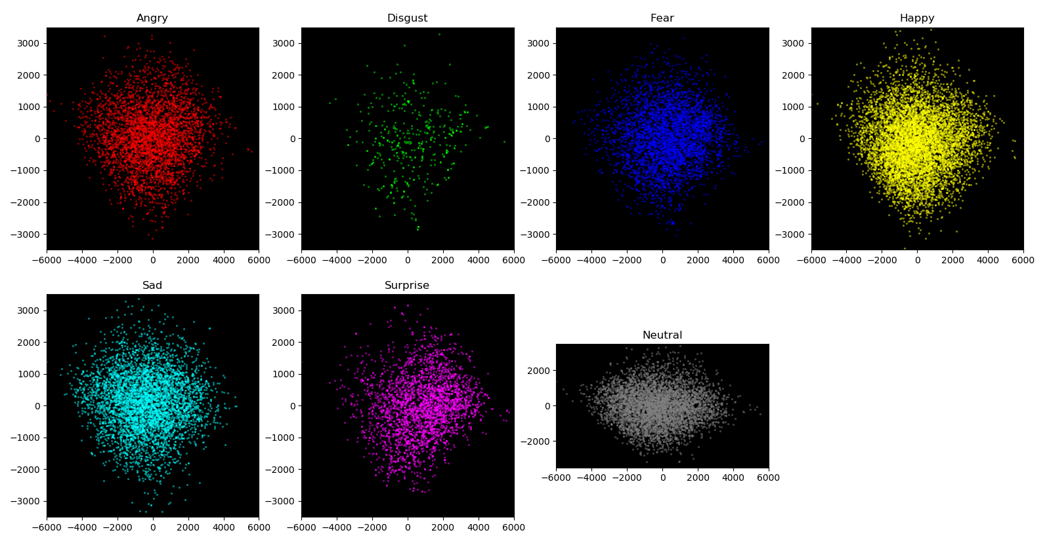
Bayesian Classifier
Accuracy with original 2304 components, 18.86% Accuracy
PCA 360 PCs, 44.25% Accuracy
Other approaches, using 360 PCs
Augmented dataset with 3, 6 & 10 degree rotations: 41.38% Accuracy
Augmented dataset with 3 & 6 degree rotations: 42.46% Accuracy
Balance the training set with random over-sampling: 43.83% Accuracy
50 iterations of random 80/20 split of training set (300 PCs): Accuracy varied 31.89% to 44.41%
Scatter plot across the first two PCs, with each class shown in a separate plot

Slide 9
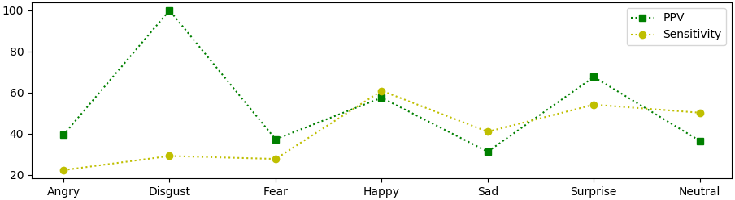
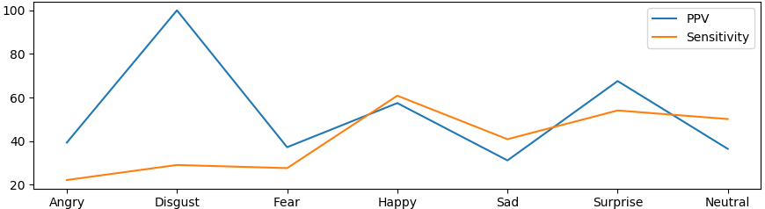
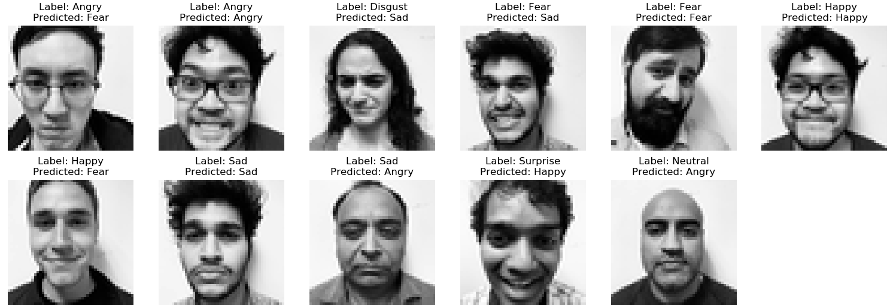
Bayesian Classifier
 | ANGRY | DISGUST | FEAR | HAPPY | SAD | SURPRISE | NEUTRAL
PPV (Precision) | 39.4% | 100% | 37.2% | 57.5% | 31.2% | 67.6% | 36.5%
Sensitivity (Recall) | 22.2% | 29.1% | 27.7% | 60.9% | 40.9% | 54.1% | 50.2%
14% Accuracy on New Data

Slide 10
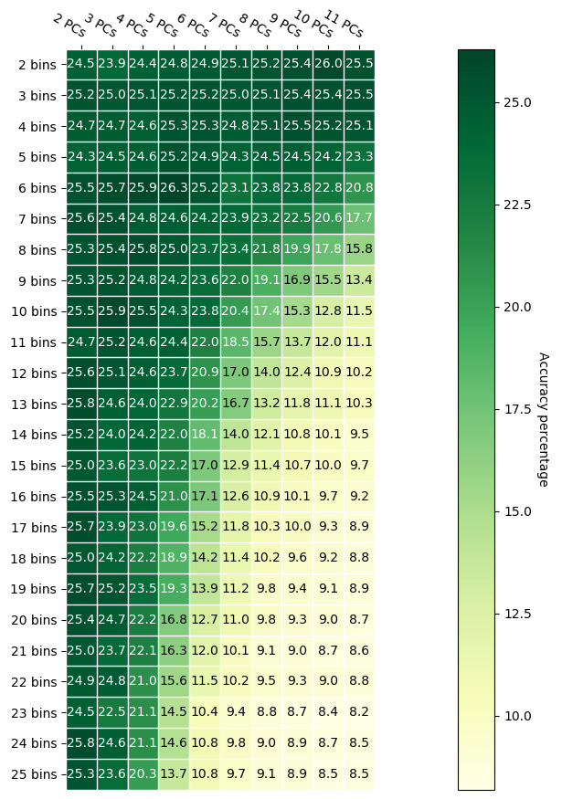
Histogram Classifier
Why did Histogram classifier not work?
Say, we use 8 PC features, and 8 bins, we have ~17million bins in a histogram, but only 28709 data points. So, a very sparsely populated histogram.
When we look to predict with such a histogram, bins corresponding to queries are likely empty, resulting in no prediction.
Table shown to the left indicates this condition.

Slide 11



Neural Network – Fully Connected
16% Accuracy on New Data
40.38% Accuracy on Training Data
36.8% Accuracy on Test Data
Label = 1 (Disgust)
Predicted = 4 (Sad)
Layer (type) | Output Shape
Convolutional 2D | 64, 48, 1
Batch Normalization | 64, 48, 1
Max Pooling | 64, 24, 1
Convolutional 2D | 128, 24, 1
Batch Normalization | 128, 24, 1
Flatten (2D -> 1D) | 3072
Tanh (Dense) | 2304
OUTPUT | 7
Label = 4 (Sad)
Predicted = 4 (Sad)
Label = 5 (Surprise)
Predicted = 3 (Happy)

Slide 12
Model performance - Summary
 | Original components |  | With PCA |  | With Data Augmentation – Test Accuracy
 | Training Set Accuracy | Test Set Accuracy | Training Set Accuracy | Test Set Accuracy
Linear Classification Analysis | 48.30% | 34.88% | 39.41% | 18.02% | 32.21%
Bayesian Classifier | 50.73% | 18.86% | 76.61% (with 360 PCs) | 44.25% (with 360 PCs) | 41.38% (with 360 PCs)
Logistic Regression Analysis | 31.40% | 31.23% | 31.40% | 31.23% | 33.11%
Neural Network |  |  | 53.78% (with 360 PCs, not normalized) | 34.55% (with 360 PCs, not normalized) | N.A.

Slide 13
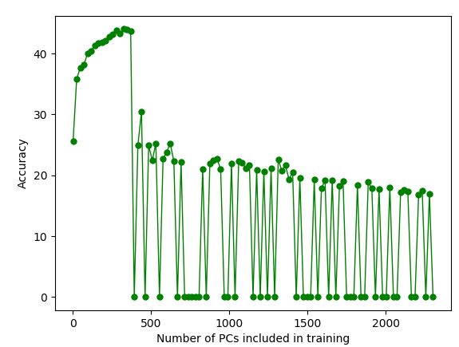
Interesting Observations
Bayesian classifier accuracy falls after a certain number of Principal Components
PCA gave us 2304 PCs. And initially, for the first ~360 components, adding them to training set improved the accuracy. But beyond that, accuracy started to decline.
Beyond 370 PCs, the covariance matrices get quite large, and unstable. Many cases, the determinant (for Disgust class) evaluates to a negative value, preventing predictions as well.
100% PPV in Disgust class for Bayesian classifier and rest PPVs are lower. Reason might be unbalanced classes determined by their counts.
Principal components make the distributions more Gaussian
NOTE: even for lesser number of PCs, switched to ‘numpy.linalg.slogdet()’ and determined ‘pdf’ on a log scale, as ‘numpy.linalg.det()’ fails with “RuntimeWarning: overflow encountered”.
Gaurav to review and update

